Slide 1
Session 3:METHODOLOGY
Bayesian Sensor Fusion &
Gaussian Process Mapping
For Human–Robot Collaborative Hygiene Monitoring and Surface Disinfection
Case Study Assistive Robotics for Improvement Quality of Life
Presented by:
Alwa Jyoshna
Vallepu Vishnu
Kappala Mahesh

Slide 2
SESSION OUTLINE
1
Research Problem Statement
2
Modelling Approach — Bayesian Sensor Fusion
3
Spatial Mapping — Gaussian Process Regression
4
Model Inputs, Assumptions & Data Sources
5
Decision Policy & HRC Rules
6
End-to-End Process Flowchart

Slide 3
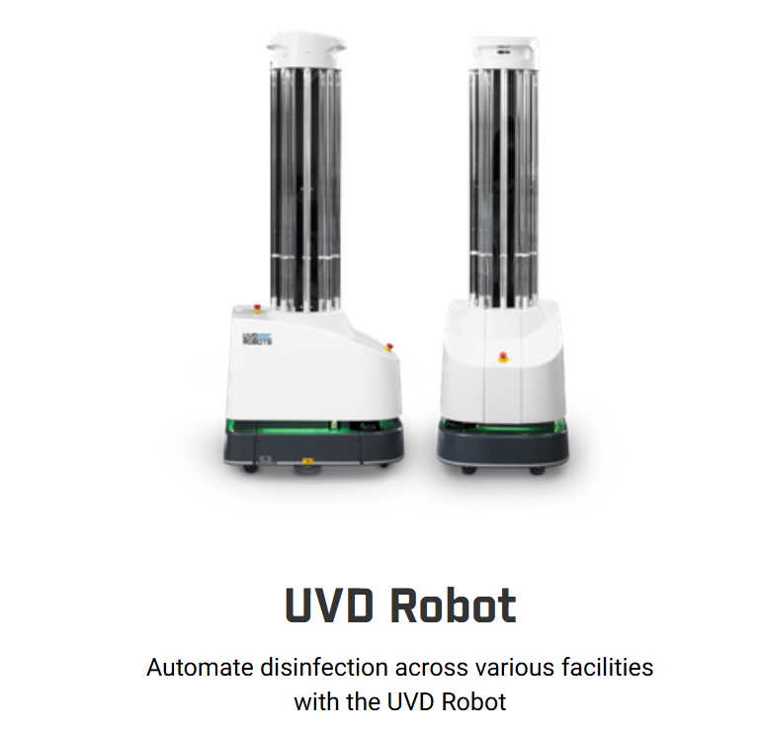
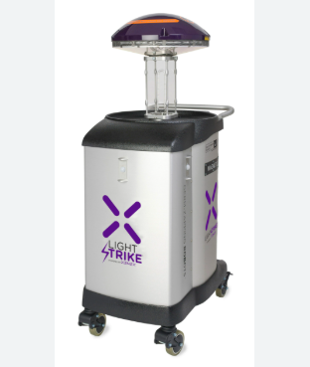
Existing Disinfection Robots:
Xenex Robot

Slide 4
RESEARCH CONTEXT & PROBLEM STATEMENT
LIMITATIONS
Proposed Framework Addresses:
No automatic contamination estimation
Bayesian Fusion — Combines 4 sensor modalities optimally
Shadowed areas may not receive UV light
GP Spatial Map — Covers observed + unobserved patches
Sensors used in isolation, not fused
Calibrated Uncertainty — Quantified confidence at every patch
No spatial hygiene map for unobserved areas
HRC Decision Rules — Autonomy where safe, human input where uncertain
Full cognitive burden remains with operator
Cleanliness Verification — Probabilistic, not just path-level

Slide 5
MAIN MODELLING APPROACH
LAYER 1
Sensing
LAYER 2
Bayesian Fusion
LAYER 3
GP Mapping
LAYER 4
Decision Policy
Raw multi-modal data acquisition
RGB-D · Fluorescence · Hyperspectral · UV-dose
Precision-weighted posterior per patch
Closed-form Gaussian estimator
Spatial interpolation via RBF kernel
Full probabilistic hygiene map (9/9 coverage)
Priority score · UV exposure time
HRC collaboration rules
Each layer is independently modular and replaceable without affecting the others

Slide 6
BAYESIAN MULTI-SENSOR FUSION — MODEL
Sensor Measurement Model
Closed-Form Posterior
z_{m,i} = f_i + ε_m, ε_m ~ N(0, σ²_m)
Posterior Precision:
σ⁻²_fused = σ⁻²₀ + Σ σ⁻²_m
RGB-D Camera
σ² = 0.04
Visual texture & geometry
Posterior Variance:
Fluorescence
σ² = 0.01
σ²_fused = 1 / (σ⁻²₀ + Σ σ⁻²_m)
Organic / biological residue
Posterior Mean:
Hyperspectral
σ² = 0.02
Material & spectral features
μ_fused = σ²_fused · (μ₀/σ²₀ + Σ z_m/σ²_m)
UV-Dose Model
σ² = 0.03
Key Property: σ²_fused < σ²_m for all m
→ Adding any sensor always reduces uncertainty
Irradiance delivered to patch

Slide 7
GAUSSIAN PROCESS SPATIAL MAPPING
GP Prior
Hygiene Map — 3×3 Grid Example
f(x) ~ GP( μ₀, k(x, x') )
P7
~0.80
P8
0.70
P9
~0.65
RBF Kernel: k(xᵢ,xⱼ) = σ²_f · exp(−‖xᵢ−xⱼ‖²/2l²)
GP est.
observed
GP est.
Length-scale l = 1.0, Signal variance σ²_f = 1.0
P4
0.90
P5
0.24
P6
~0.30
GP Posterior Equations
observed
observed
GP est.
μ_* = K_*ᵀ (K + Σ_n)⁻¹ y
P1
0.79
P2
0.52
P3
~0.52
Σ_* = K_** − K_*ᵀ (K + Σ_n)⁻¹ K_*
observed
observed
GP est.
Σ_n = diag(σ²_fused) from Bayesian fusion outputs
Disinfect
Monitor
Clean
GP Only

Slide 8
MODEL ASSUMPTIONS
Gaussian Sensor Noise
Independent Sensor Noise
A1
Each sensor error ε_m ~ N(0, σ²_m). Enables closed-form Bayesian posterior. May not hold for fluorescence on complex surfaces — approximate Bayes (EP/VI) needed if violated.
A4
Noise terms of different sensors are mutually independent. Simplifies the precision-sum formula. Cross-sensor correlations (e.g. both affected by lighting) would require a joint noise model.
Spatial Smoothness (RBF Kernel)
Stationary Contamination During Scan
A2
Contamination is spatially correlated with smooth decay over distance. RBF chosen for mathematical tractability. Sudden discontinuities (e.g. sealed patches) require Matérn kernel.
A5
Surface contamination does not change during a single robot traversal. Valid for single scans; requires recursive Bayesian / Kalman filter extension for continuous temporal monitoring.
Contamination ∈ [0, 1]
Known Sensor Noise Variances
A3
Scalar bounded representation f_i ∈ [0,1]. Interpretable and compatible with both fusion and GP. Assumes all modalities can be normalised to this range prior to fusion.
A6
σ²_m values are set from literature. In practice, these must be empirically calibrated from controlled experiments on known ground-truth surfaces before hardware deployment.

Slide 9
REQUIRED INPUTS & DATA SOURCES
Input / Parameter
Type
Value / Source
Used In
Surface patch coordinates x_i
Model input
Integer grid {0,1,2}²
GP kernel
Prior mean μ₀
Model param.
0.5 (neutral belief)
Bayesian fusion
Prior variance σ²₀
Model param.
0.09 (literature)
Bayesian fusion
RGB-D readings z_RGB
Sensor data
Simulated; real: camera
Fusion layer
Fluorescence readings z_F
Sensor data
Simulated; real: sensor
Fusion layer
Sensor noise variances σ²_m
Calibration
Literature / empirical
Fusion weights
GP length-scale l
Hyperparameter
1.0 (cross-validation)
RBF kernel
GP signal variance σ²_f
Hyperparameter
1.0 (normalised)
RBF kernel
Touch frequency T_i
Domain knowledge
Clinical / expert input
Priority score

Slide 10
DECISION POLICY & HRC RULES
Priority Score
μᵢ = contamination estimate | σᵢ = uncertainty | Tᵢ = clinical importance
Pᵢ = w₁·μᵢ + w₂·σᵢ + w₃·Tᵢ
Adaptive UV Dose
D_req = D_base · (1 + λ·μᵢ + κ·σᵢ) → t_i = D_req / I_i
IF: μᵢ > 0.7
IF: σᵢ > 0.3
THEN: AUTONOMOUS DISINFECT
THEN: REQUEST HUMAN INSPECT
High-confidence contamination detected
Uncertainty too high for autonomous action
IF: Proximity detected
IF: μᵢ < 0.2 & σᵢ < 0.1
THEN: PAUSE UV → SAFETY
THEN: CERTIFY CLEAN
UV source halted until human clears area
Both contamination and uncertainty below threshold

Slide 11
END-TO-END PROCESS FLOWCHART
1. Start: Robot Traversal Begins
5. ◆ HRC Decision Rule Applied
2. Multi-Sensor Data Acquisition (RGB-D · Fluorescence · Hyperspectral · UV-dose)
DISINFECT
(μ > 0.7)
CONFIRM
(σ > 0.3)
3. Bayesian Fusion per Patch → (μ_fused, σ²_fused)
PAUSE
(proximity)
CLEAN ✓
(μ<0.2)
4. GP Regression over Surface → Full Hygiene Map H(xᵢ)
6. Update Priority Queue & Map Log
7. All Patches Done? → End / Next Traversal

Slide 12
KEY ANALYTICAL RESULTS
91.8%
81.6%
9 / 9
4
Variance Reduction
vs Prior
MSE Improvement
vs RGB-D Only
Spatial Coverage
(vs 5/9 baselines)
HRC Decision
Categories
Method Comparison
Method
MSE (Variance)
Coverage
Full Map
RGB-D Only
0.04000
5/9
No
Fluorescence Only
0.01000
5/9
No
Kalman/EKF
~0.00800
5/9
No
Bayesian Fusion
0.00735
5/9
No
Proposed (Bayes+GP)
0.00735*
9/9
Yes ✓
* At observed patches; GP adds bounded additional uncertainty at unobserved patches.

Slide 13
METHODOLOGY SUMMARY
Framework at a Glance
Sensing
Fusion
4 modalities — RGB-D, Fluorescence, Hyperspectral, UV-Dose
Precision-weighted Bayesian posterior → 91.8% variance reduction
Mapping
Decision
RBF-kernel GP regression → 9/9 spatial coverage
Priority score + adaptive dose + 4 HRC collaboration rules
Analytical validation on 3×3 grid confirms mathematical feasibility — simulation & hardware validation as next steps

